Slide 1


Telecom Churn prediction

Slide 2
Group members
Ms. Siddhi Sayaji Ghorpade
Ms. Shruti Rajesh Bagal
Mr. Vinaykumar Vasant Patil
Mr. Sachin Balaso Ghodake
Ms. Dadi Yogitha
Ms. Yamuna Marupalli
Ms. Gadipelli Mamatha
ghorpadesiddhi05@gmail.com
shrutibagal39@gmail.com
vinayvasantpatil00@gmail.com
sachinghodake1252@gmail.com
dadiyogitha998@gmail.com
yamunasateesh@gmail.com
mamathagadipelli455@gmail.com

Slide 3
Introduction
Telecom Churn Prediction is a crucial task for telecommunication service providers to retain their customers & ensure customer satisfaction. Churn refers to the process of losing customers who switch to a competitor’s service or discontinue using the service altogether. With the increasing competition in the telecommunication industry, predicting churn has become a crucial task to minimize customer loss, reduce revenue leakage & increase customer retention. The project involves analysing customer data & identifying the factors that contribute to churn. Machine learning algorithms can be trained on this data to predict the likelihood of a customer churning, which can help companies take preventive measures to retain them. In this project, we aim to build an accurate churn prediction model using advanced machine learning techniques & explore the various factors that influence customer churn.

Slide 4
What is churn ?
Churn is an measurement of the percentage of customers that cancel or choose not to renew their subscription.
A high churn rate can negatively impact Monthly Recurring Revenue (MRR) & can also indicate dissatisfaction with a product or service.
When new customers begin buying and/or using a product, each new user contributes to a product’s growth rate. Inevitably some of those customers will eventually discontinue their usage or cancel their subscription; either because they switched to a competitor or alternative solution, no longer need to product’s functions, they are unhappy with their user experience, or they can no longer afford or justify the cost. The customers that stop using/paying are the “churn” for a given period of time.

Slide 5
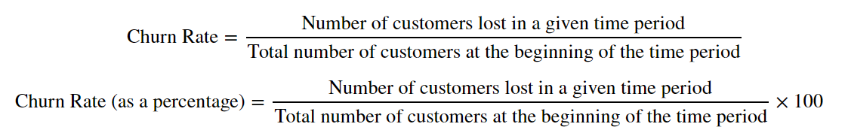

How is churn calculated ?
In the most simplistic form, the churn rate is the percentage of total customers that stop using / paying over a period of time. So, if there were 10,000 total customers in March & 1,000 of them stopped being customers, the monthly churn rate would be 10%.
Formula :

Slide 6
Pros & cons of churn :
Pros :
Provides clarity on the quality of the business.
Indicates whether customers are satisfied or dissatisfied with the product or service.
Allows for comparison with competitors to gauge an acceptable level of churn.
Easy to calculate.
Cons :
Does not provide clarity on the types of customers leaving : new / old customers
Does not differentiate between types of companies in industry comparison : startups, growing & mature business.

Slide 7
Steps :
Problem Statement Description.
Exploratory Data Analysis [EDA]
Data Visualization.
Feature Selection
Train Test Split
Balancing
Data Standardization
Models Building
Hyper Parameter Tunning
Conclusion

Slide 8
Problem statement :
The Project will aim to build the model which can predict the customer will Churn or not.
The project will also aim to provide actionable insights to help the company improve customer satisfaction & reduce churn rates.

Slide 9
Data set description :
Source dataset is in csv format.
Dataset contains 5,000 rows & 21 columns.
“churn” column is target column, which notifies whether a particular customer is churned or not.
We will be developing our models to predict the customer is churned or not.

Slide 10
Data set overview :
Each row corresponds to a client of a telecommunications company for whom it has collected information about the type of plan they have contracted, the minutes they have talked, or the charge they pay every month
The data set includes the following 20 variables :
state : Categorical, for the 51 states & the district of Columbia.
area.code :
account.length : How long the account has been active.
voice.plan : Yes or no, voicemail plan.
voice.messages : Number of voicemail messages.
intl.plan : Yes or no, international plan.
intl.mins : Minutes customer used service to make international calls.
intl.calls : Total number of international calls.
intl.charge : Total international charge.
day.mins : Minutes customer used service during the day.
day.calls : Total number of calls during the day.
day.charge : Total charge during the day.
eve.mins : Minutes customer used service during the evening.
eve.calls : Total number of calls during the evening.
eve.charge : Total charge during the evening.
night.mins : Minutes customer used service during the night.
night.calls : Total number of calls during the night.
night.charge : Total charge during the night.
customer.calls : Number of calls to customer service.
churn : Categorical, yes or no. Indicator of whether the customer has left the company (yes or no).

Slide 11
EDA (Exploratory Data Analysis)
Checking and Treat the
Data type according column content
Null values
Duplicate values
Outliers
Label Encoding

Slide 12
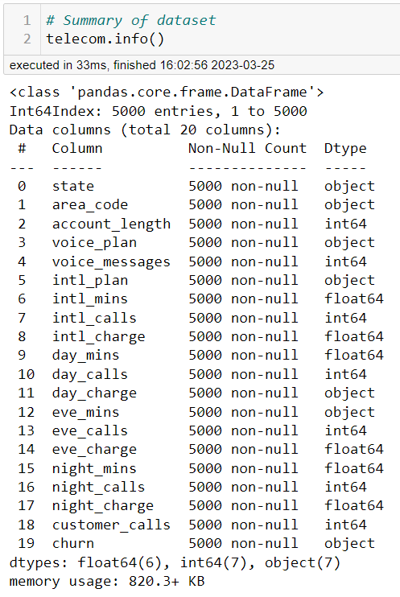
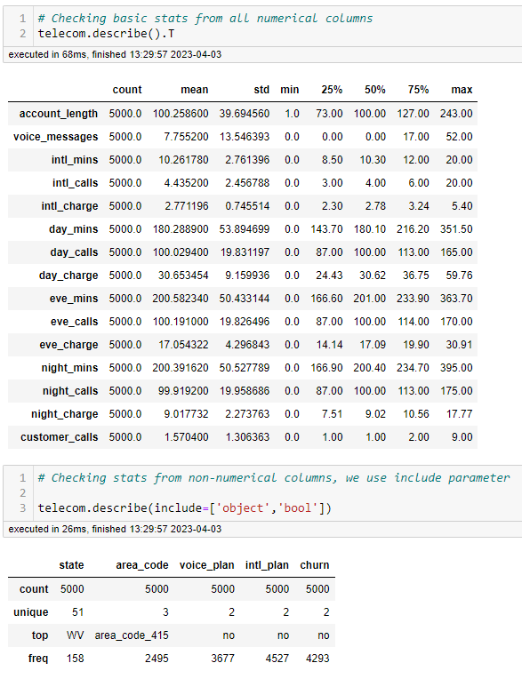
eda :
Dimensions of data set.
Summary of data set.
Detecting missing values & filled with median values of that columns.
Basic statistical information about numerical & non-numerical columns in data set.
Outliers detection & reducing outliers by using IQR method.

Slide 13
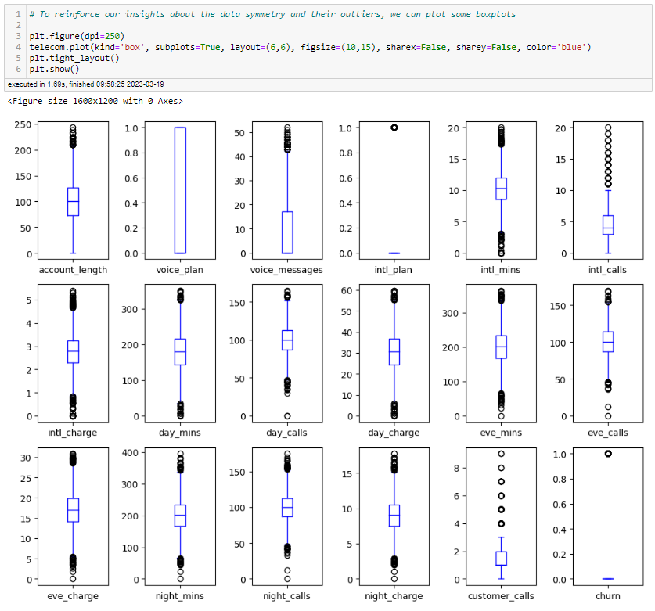
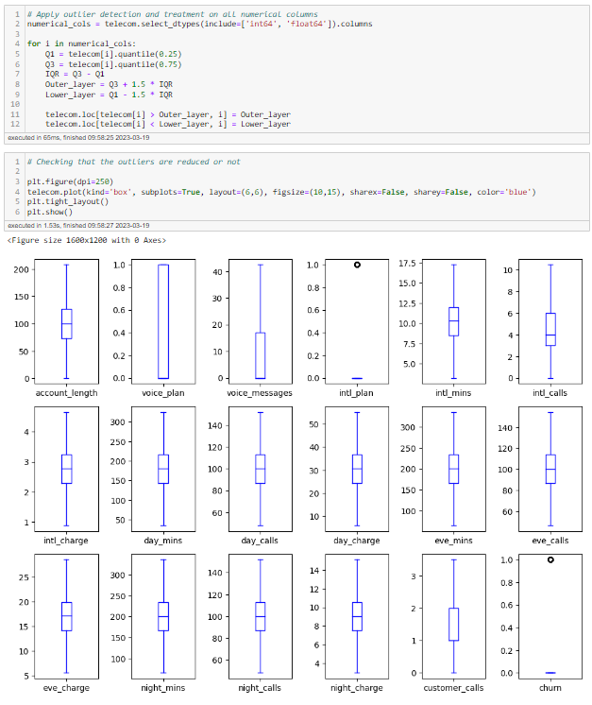
Box Plot
As we see, outliers are present in given data set.
As we see, outliers are reduced by after using IQR method.

Slide 14
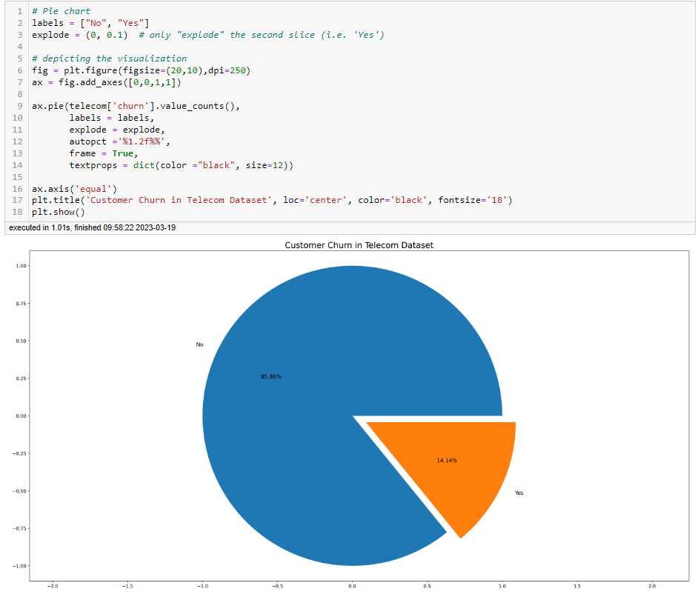
Visualization Pie chart
This pie chart shows that the customers from the data are likely to be continuing their subscriptions plans (85.86%) & some customers are cancel or choose not to renew their subscriptions which is 14.14%.

Slide 15
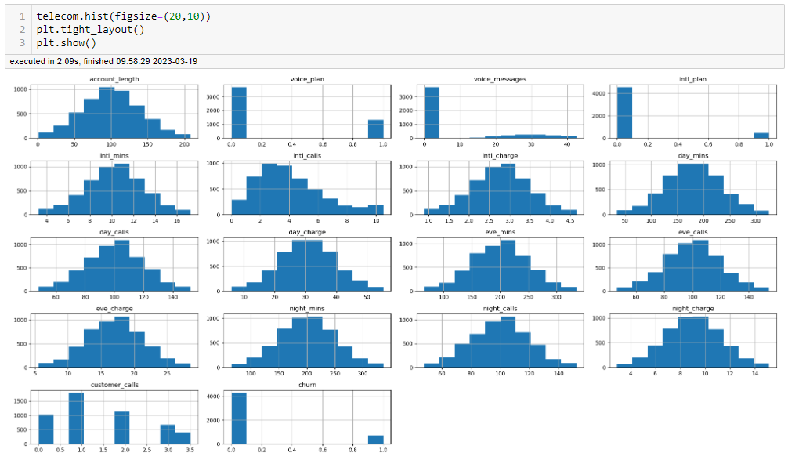
histogram
In histogram we see that the some features are normally distributed, some features are positively skewed & some features are left skewed in nature.

Slide 16
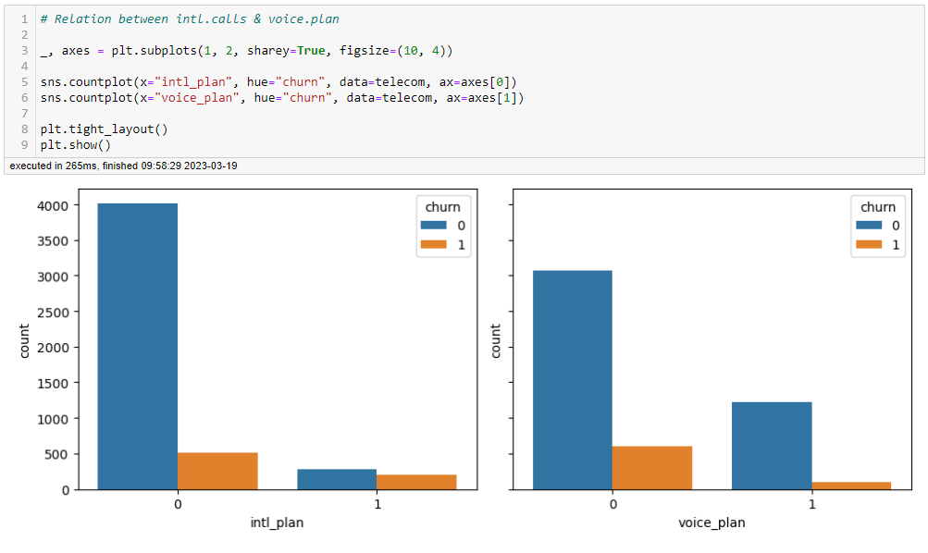
Count plot
Comparing international plan & voice plan features, with churn feature by using count plot :
Customers having international plan those are highly churned & those customers are not having international plan are less churned.
In voice plan we do not observe that same effect of international plan.

Slide 17
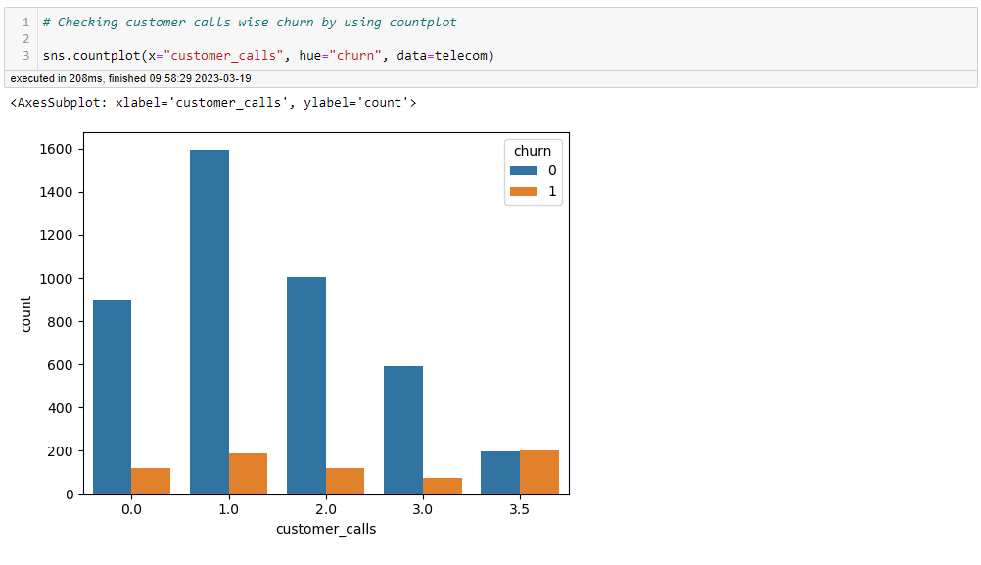
Count plot
In this count plot we see that :
Churn rate increases significantly after 3 customer calls.
After one customer calls company losses loyal customers.

Slide 18
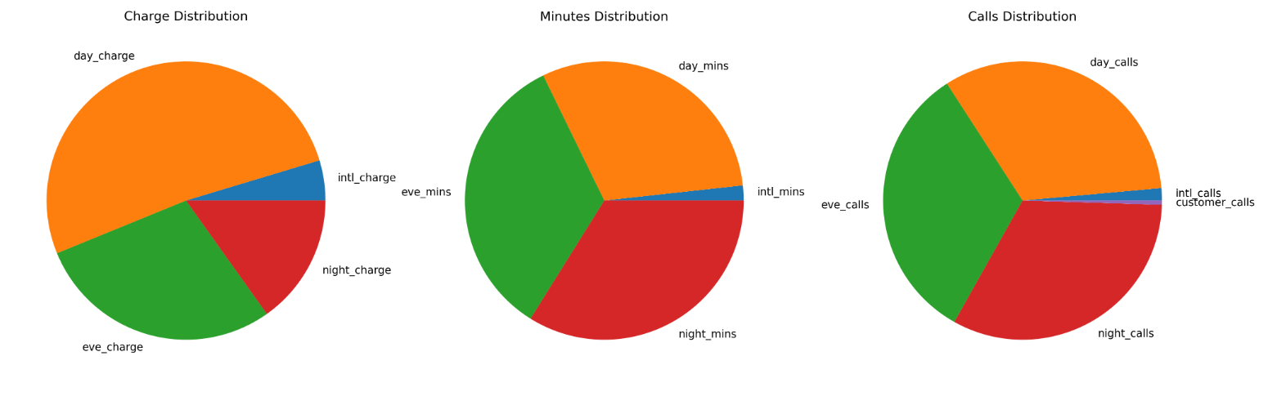
Pie chart
In charge distribution pie chart we see that day charges are high, then evening charges, then night charges & international charges are low.
In minutes distribution pie chart we see that night minutes are high, then day & evening minutes are same but the international minutes are less than others.
In calls distribution we see that the day, evening & night calls are same but the international calls are low & customer calls are more less than others.

Slide 19
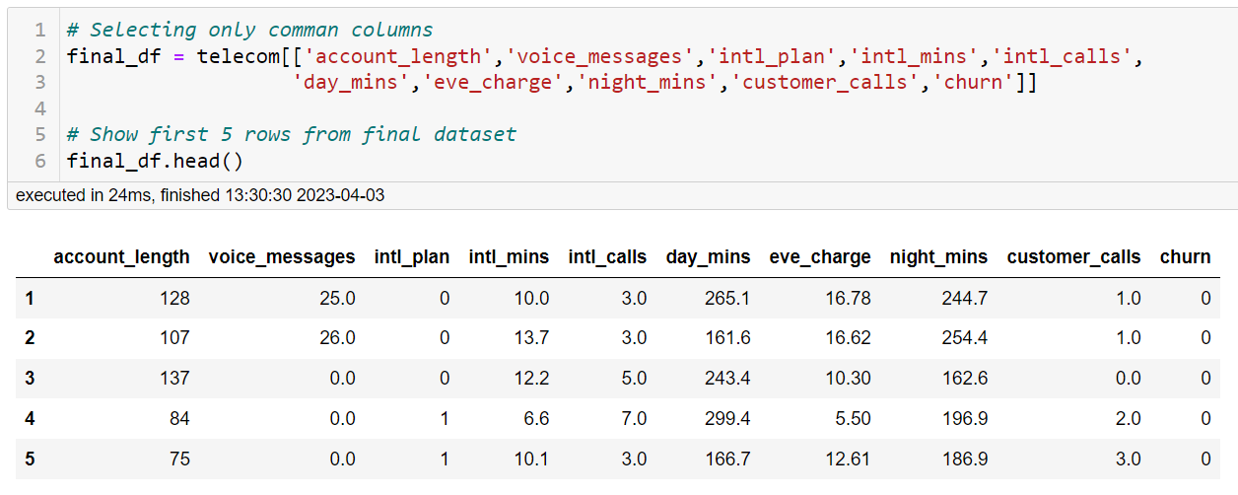
Feature selection :
To select the relevant features we try 5 different methodology also 1 visualization technique.
Selected Features:
Depend on all this approaches we are select those column which are common in all these method.
Correlation Analysis : Checking relation between each independent column to target column churn
Univariate Selection : Using Chi -Square
Tree Based Method : Using DecisionTreeClassifier
Recursive Feature Elimination [RFE] : Using LogisticRegression as estimator
Predictive Power Score [PPScore]
T-distributed Stochastic Neighbour Embedding [t-SNE]: for visualizing the pattern.

Slide 20
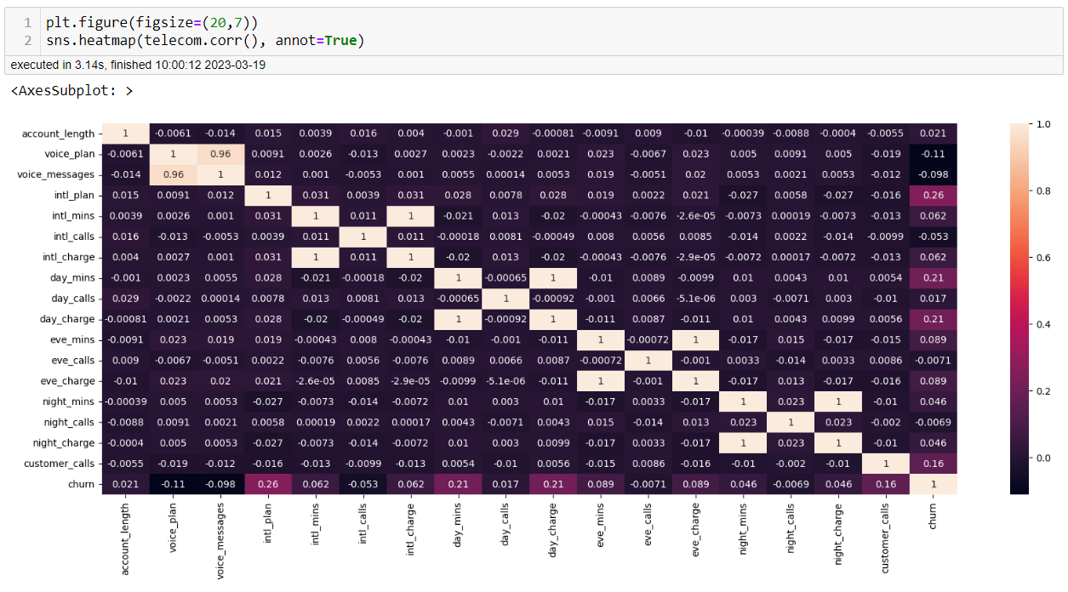
Correlation analysis :
For correlation analysis we use heatmap for visualizing correlation between each column.
In this heatmap we see that 8 columns are multicollinear with each others.
For reducing multicollinearity, we drop 4 columns which shows high VIF value

Slide 21
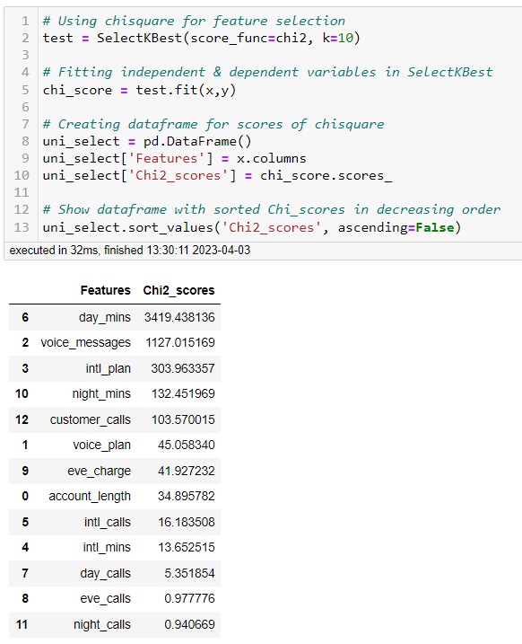
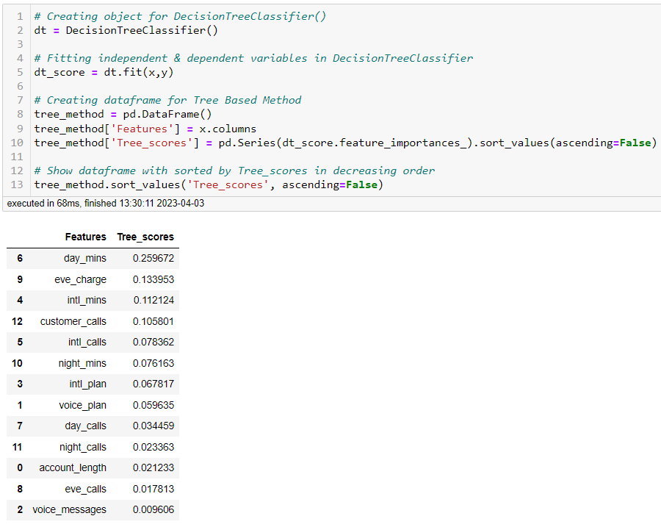
UNIVARIATE SELECTION :
TREE BASED METHOD :

Slide 22
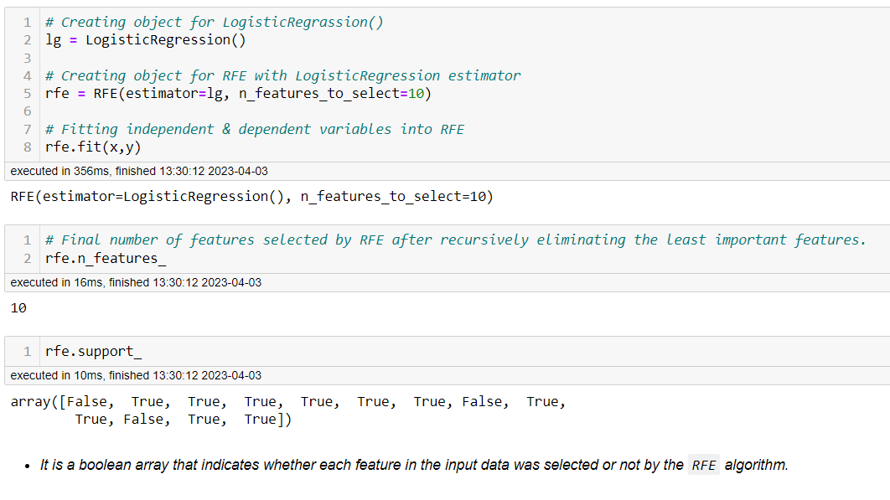
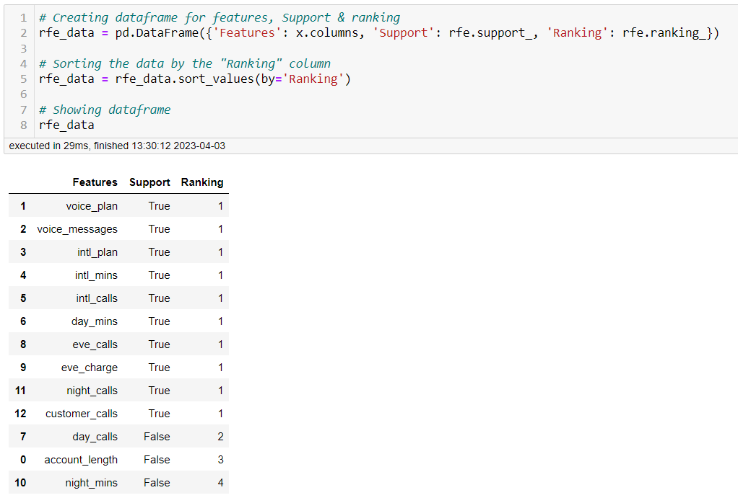
Recursive feature elimination [RFE] :

Slide 23
Some Steps Before the Model Building
Train Test Split :
Split data into train & test for model building.
Balance Data :
Data is imbalanced, for balancing the data we use RandomOverSampler library.
Standardizing data :
Using StandardScaler we done scaling of the data.

Slide 24
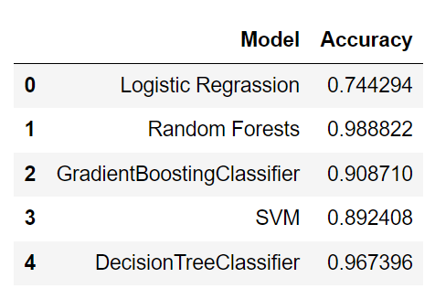
Model Building
To build the model we use five algorithms :
Logistic Regression
Random Forest Classifier
Gradient Boosting Classifier
Support Vector Machine(SVM)
Decision Tree Classifier

Slide 25
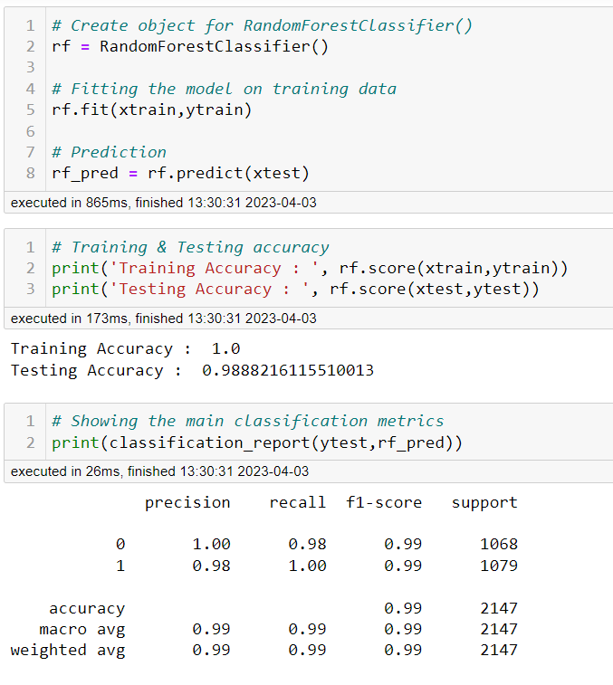
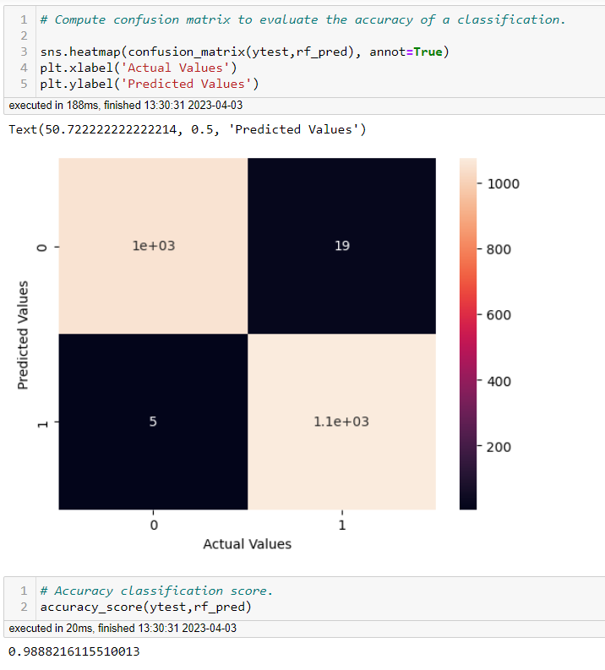
Random forest classifier model :

Slide 26
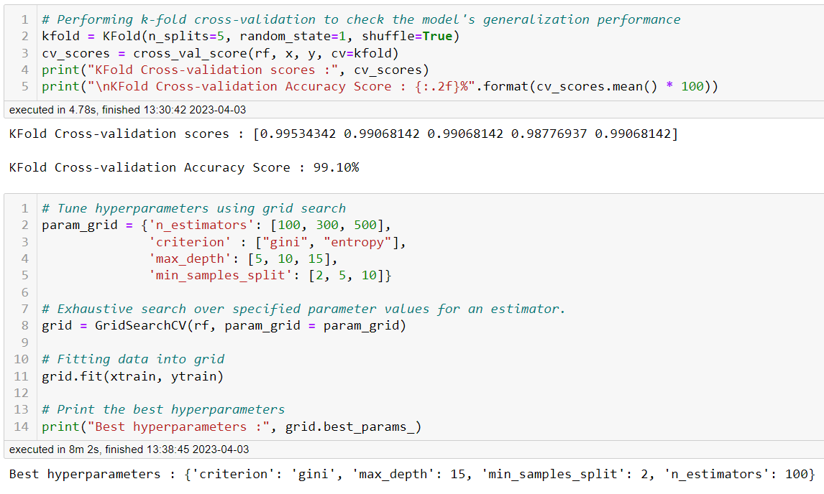
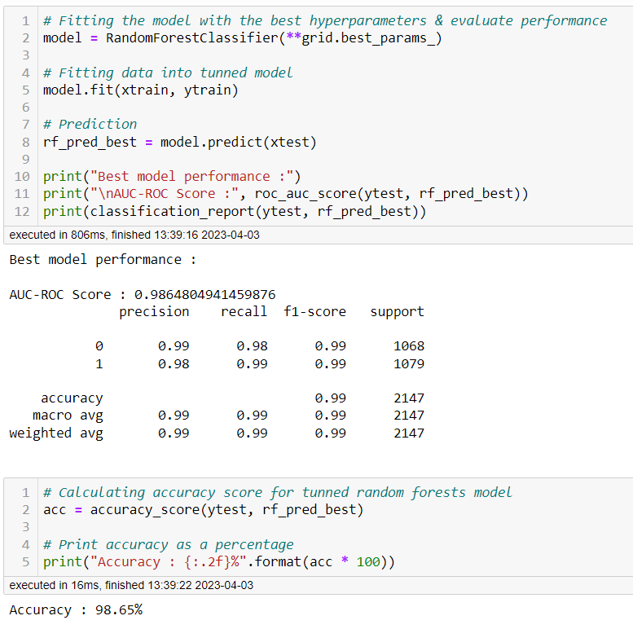
Kfold cross validation & Hyper parameter tunning

Slide 27
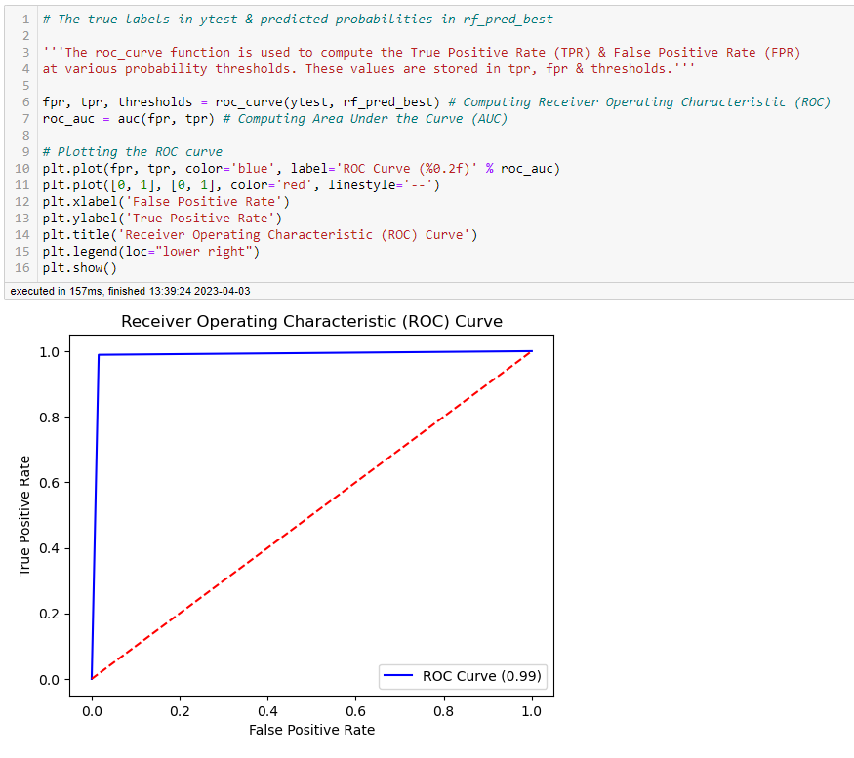
Roc curve
Receiver Operating Characteristic
ROC curve shows a perfect classifier, it means that the `Random Forest Classifier` model is able to perfectly distinguish between the positive & negative classes.

Slide 28
Findings & suggestions :
Try to offer the better service for the churned customers, see how much this impact before & later. Some may use your service better move them to your active customers.
Take the feedback & suggestions with in period of time & improve it.
Improve the communication on customer calls.
Improve international services.
When your are taking the any change in plans of your business just predict the positive & negative share of that plan. If it is negative prepare the solution before so you can handle easily.

Slide 29
How can you reduce churn :
Churn is reduced by increasing the perceived value proposition of the product to current users. This can be achieved in a number of ways since the value is determined based on several factors :
Lean into your best customers.
Be proactive with communication.
Define a roadmap for new customers.
Offer incentives.
Ask for feedback often.
Analyse churn when it happens.
Stay competitive.
Provide excellent customer service.
Create a community around your customers.
Focus on attracting the right customers.
Make it easy for customers to stay long term.

